Slide 1

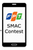
Architecture: Bus Routing

Slide 2
Architecture: Bus Routing
1a. Text Search

Slide 3

Architecture: Bus Routing
1b. Voice Search
1a. Text Search

Slide 4
Architecture: Bus Routing
1b. Voice Search
1c. Text
1a. Text Search

Slide 5

Architecture: Bus Routing
Bus Service
1b. Voice Search
1c. Text
1a. Text Search

Slide 6
Architecture: Bus Routing
Bus Service
1b. Voice Search
1c. Text
2. Request bus route
1a. Text Search

Slide 7
Architecture: Bus Routing
Bus Service
1b. Voice Search
1c. Text
2. Request bus route
3. List results
1a. Text Search

Slide 8
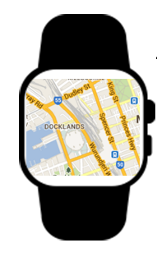
Architecture: Bus Routing
Bus Service
1b. Voice Search
1c. Text
2. Request bus route
3. List results
1a. Text Search
Android Wear

Slide 9
Architecture: Bus Routing
Bus Service
1b. Voice Search
1c. Text
2. Request bus route
3. List results
1a. Text Search
3. Sync data when on street
Android Wear

Slide 10

Architecture: Bus Routing
Bus Service
1b. Voice Search
1c. Text
2. Request bus route
3. List results
1a. Text Search
3. Sync data when on street
Android Wear
Text To Speech API

Slide 11
Architecture: Bus Routing
Bus Service
1b. Voice Search
1c. Text
2. Request bus route
3. List results
1a. Text Search
3. Sync data when on street
4. Request sound files
Android Wear
Text To Speech API

Slide 12
Architecture: Bus Routing
Bus Service
1b. Voice Search
1c. Text
2. Request bus route
3. List results
1a. Text Search
3. Sync data when on street
5. Sound files
4. Request sound files
Android Wear
Text To Speech API

